Slide 1
Climate (In) Justice
March 27, 2020
EIJC

Slide 2
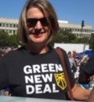
Introduction – Natascha Finnerty
Climate mitigation must include consideration of climate inequities

Slide 3
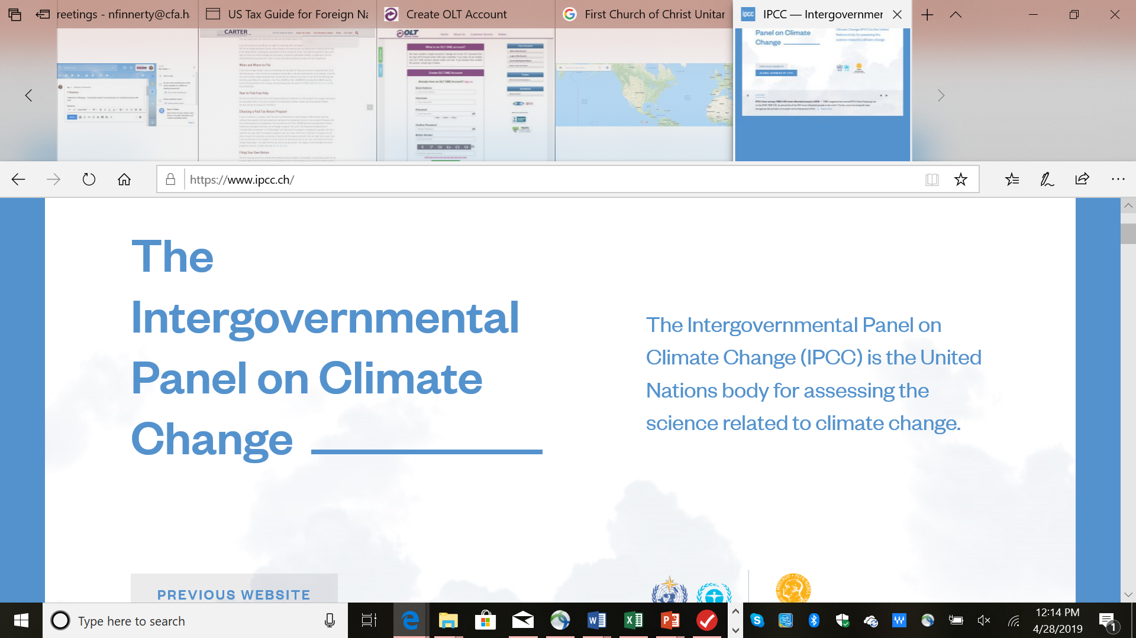
Call to Action – 12 – now 11 Years
UN IPCC Report
October 2018
The UN panel of leading climate scientists reviewed over 6,000 peer reviewed studies:
Globally, we need to reduce greenhouse gas iemissions by 45% by 2030 n order to avoid mass extinctions, famines, displacement, and diseases starting as early as 2040.
And to avert human catastrophe, we must be down to net zero emissions by 2050.
We have the technological solutions to this
crisis, we don’t have the political will.

Slide 4
State is not moving fast enough
GHG levels targets approved into law in 2008 are not likely to be met.
Each year of delay means more action in the future.

Slide 5
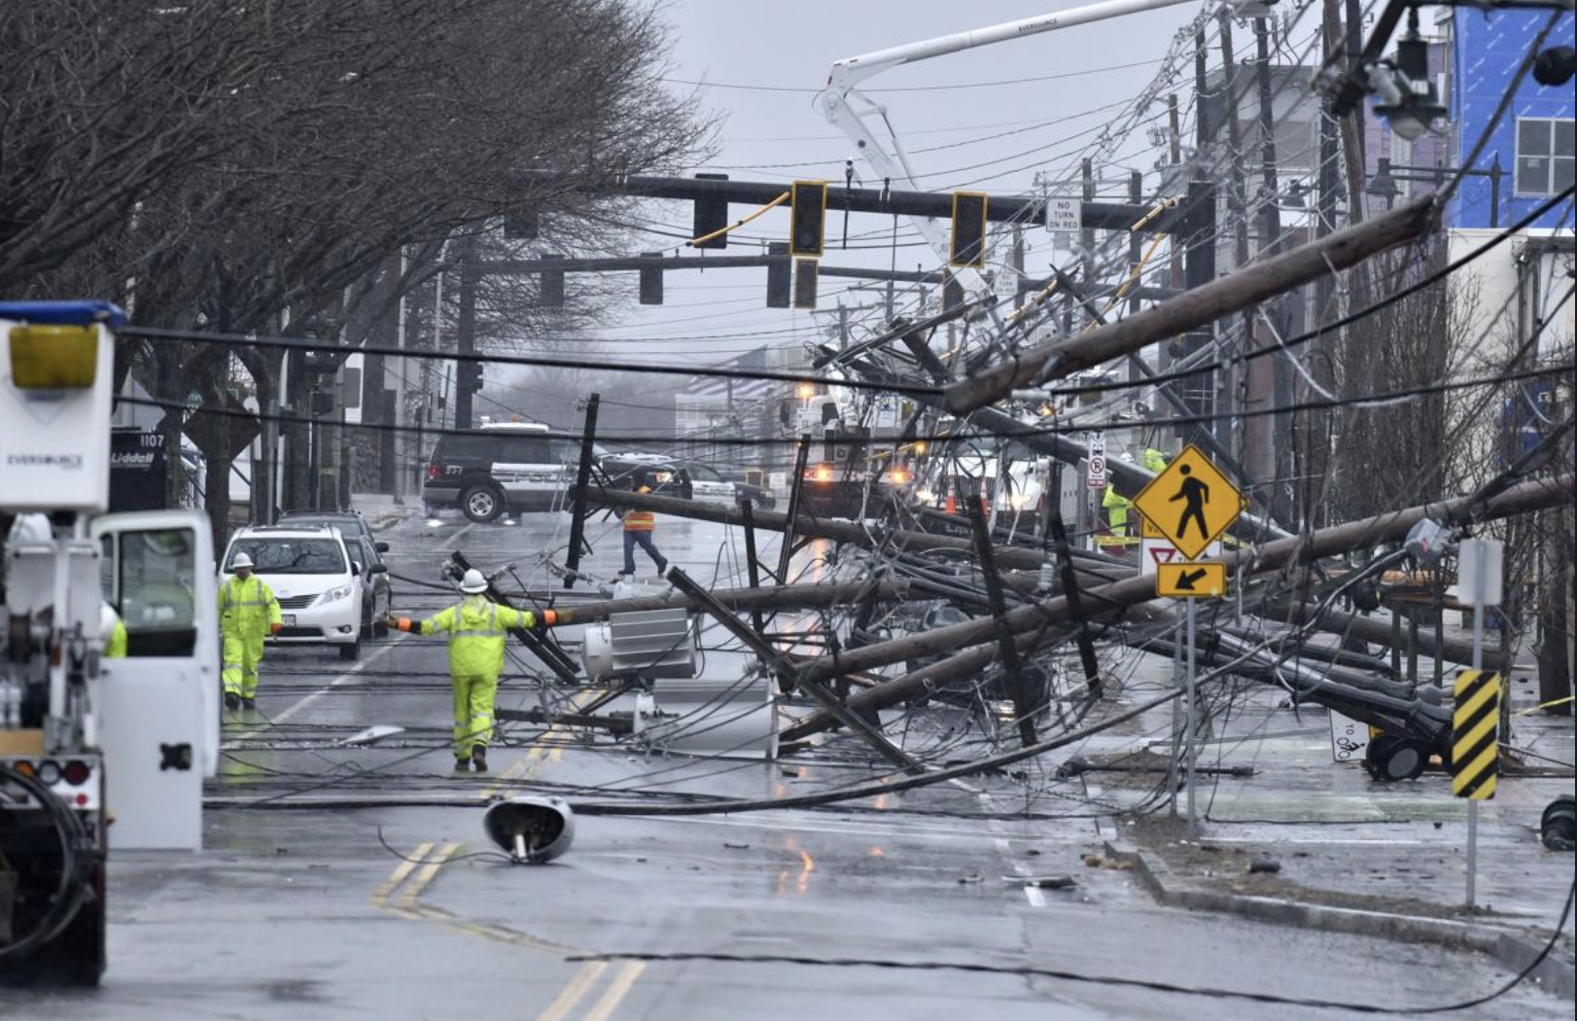
CLIMATE CHANGE IN MASSACHUSETTS

Slide 6
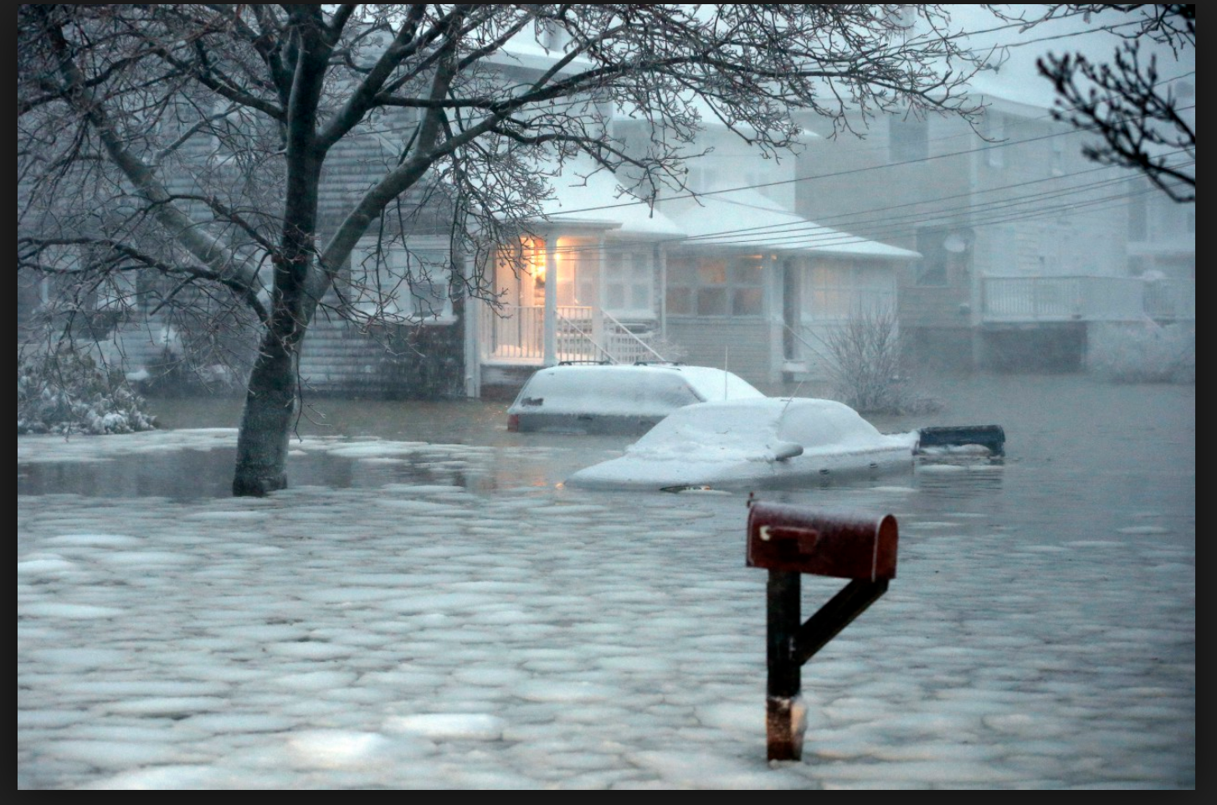
Climate change in Mass
Scituate

Slide 7
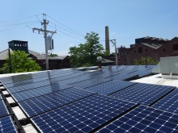
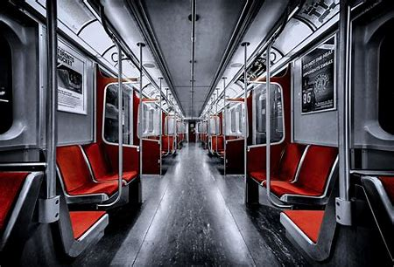
The Solutions
Vastly invest to improve energy efficiency
Convert systems now powered by fossil fuels (transportation, building heating and cooling) to renewables and eventually 100%
Reduce transportation CO2
(teleworking, car pooling)
Revise our agricultural practices - meat consumption and change our farming processes
This is a massive undertaking, how would we transform our energy, farming and industrial economies so comprehensively? – We have the tools - Reuse, conserve and the Green New Deal

Slide 8
Why Equity Matters
There is morality. It matters how we treat our fellow beings, and what kind of world we leave for those who follow us. Centrally, the Climate Crisis, like the Inequality Crisis, is one of exploitation.
How did we get here?
Our economic models minimize the costs of exploitation – whether it is of lands, air, water, wildlife, or people. Individuals have built immense power precisely because of their non-sustainable practices. There is little to no elite political will to stop these exploitative practices.
How do we change this model?
By building a multigenerational grassroots movement to create the political will through public pressure and the voting booth.
We must stop treating people, lands, air, water as disposable – we need a just transition to a sustainable economy.

Slide 9
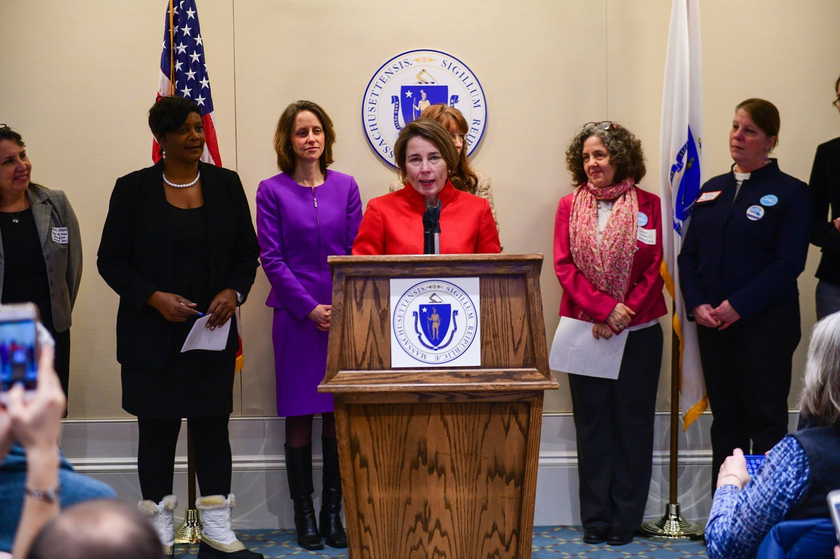
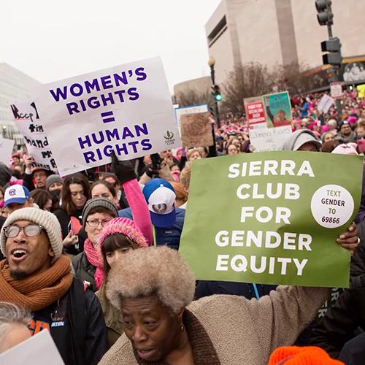
Building a Movement Across Coalitions
Automatic Voter Registration Lobby Day, Jan 2018
“Our two biggest problems are climate change and income inequality. If we pit one against the other, neither will win.”
- Michael Brune, Executive Director, Sierra Club

Slide 10
Your health and life expectancy is dependent on your zip code

Slide 11
More serious health threats are faced by poorer communities because of higher rates om air, water and ground pollution
Many African American communities face serious health risks caused by air pollution. Higher poverty levels increase these health threats from air pollution translating into a bigger health burden on African American communities.
And, companies often site high polluting facilities in or near communities of color, furthering the unequal distribution of health impacts. This paper for the first time quantifies the elevated health risk that millions of African Americans face due to pollution from oil and gas facilities.
Fumes Across the Fence-Line Clean Air Task Force – NAACP 2017

Slide 12
It is not a coincidence that so many African Americans live near oil gas development. Historically, polluting facilities have often been sited in or near African American communities.
Companies take advantage of communities that have low levels of political power.
In these communities, companies may face lower transaction costs associated with getting needed permits, and they have more of an ability to inﬂuence local government in their favor.

Slide 13
SAO – MethaneSat project
EDF TedTalk

Slide 14
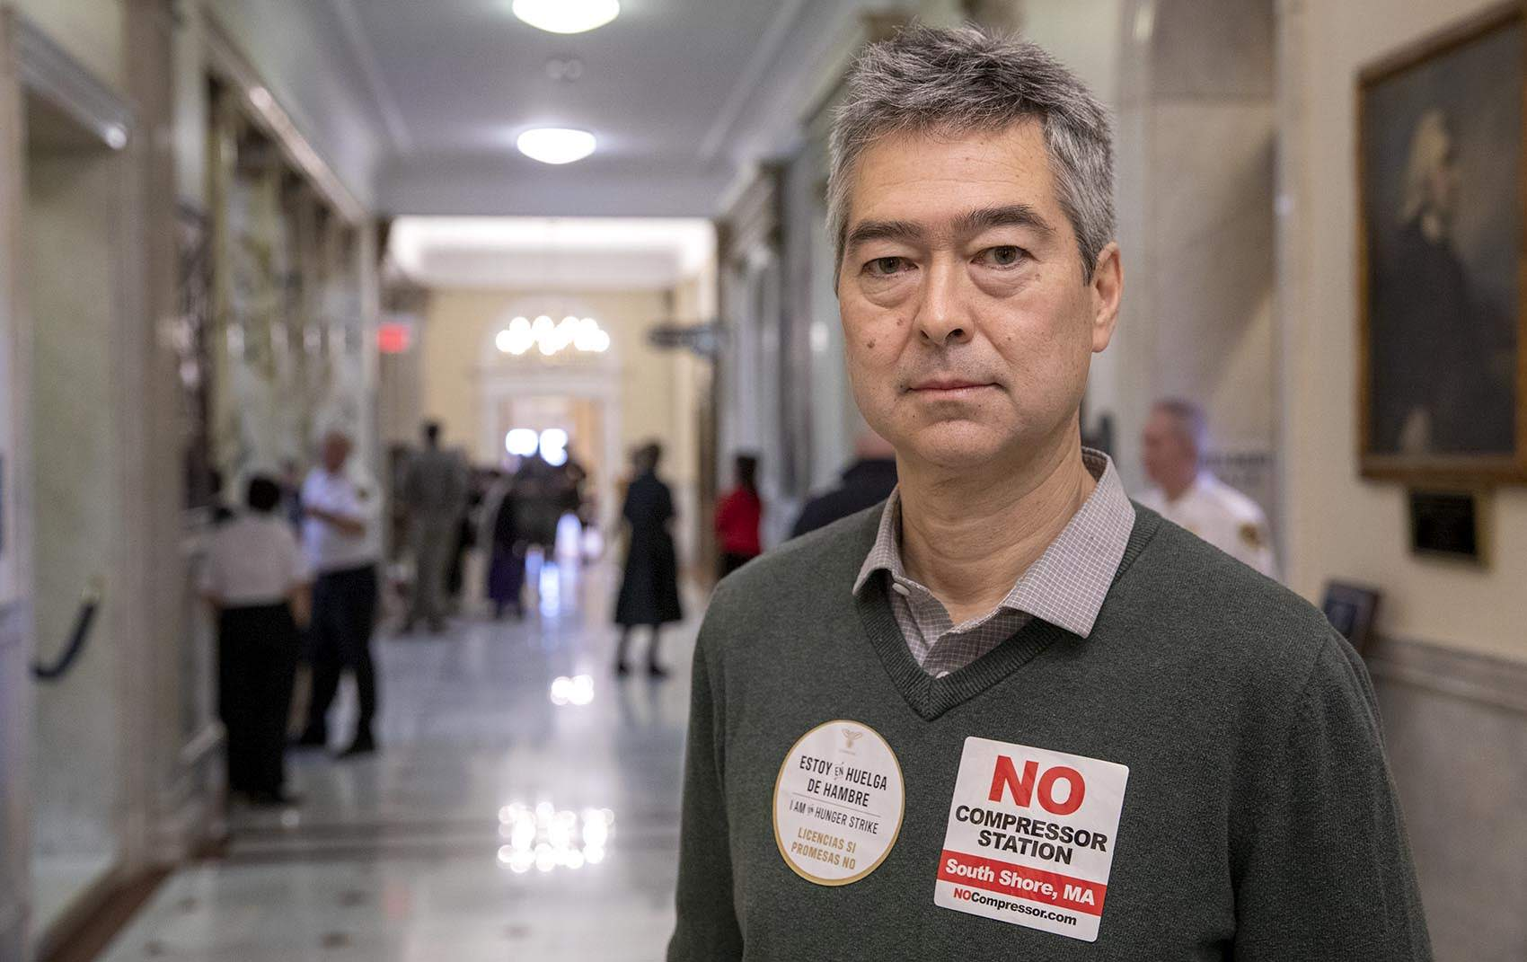
Dr. Nathan Phillips, BU
Merrimack Gas Explosions

Slide 15
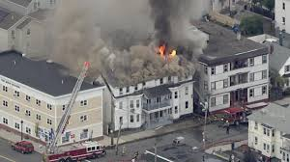
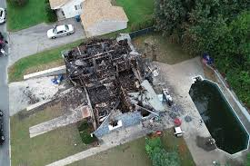
Lessons from the 2018 Merrimack Valley Gas Fires
Comparing Recovery Processes and Disaster Resilience across Socioeconomic and Political Divides

Slide 16
THREE TOWNS, THREE DIFFERENT DEMOGRAPHICS
LAWRENCE 80% HISPANIC, AVERAGE INCOME IS $39,627 – 20% LIVE IN POVERTY. SUFFERED MORE DEINDUSTRIALIZATON
NORTH ANDOVER – 80% NON HISPANIC, AVERAGE INCOME IS $143,292 – 5% LIVE IN POVERTY
ANDOVER – SMALLER THAN NORTH ANDOVER, INCOME IS $105,661

Slide 17
CHANGE IN THE DEFINITION OF A DISASTER
“An event, concentrated in time and space, in which a society... undergoes severe danger and incurs such losses to its members and physical appurtenances that the social structure is disrupted and the fulfillment of… essential functions of the society is prevented.” p. 18
The first change, how “disaster” is defined, coincided with changes throughout the field of sociology as scholars began to realize that patterns of vulnerability are linked to broader sociopolitical contexts. p. 19 The definition of “disaster” as the “episodic, foreseeable manifestations of the broader forces that shape societies.”
Hurricane Katrina and Flint Water crisis
“The study of disaster has also started to explicitly incorporate diversity and inequality into discussions of disaster, including race, gender, income, etc.”

Slide 18
The lack of financial resources
The lack of financial resources, for instance, had two effects on residents’ ability to recover:
it amplified the daily struggle and
slowed down the recovery effort which prolonged displacement.
Less financially affluent residents were less likely to self-mitigate because it was too expensive, which led to longer disruption and displacement

Slide 19
There was a strong difference between “inconvenient” and “debilitating.”
While the crisis was disruptive and unpleasant for all respondents, there appeared to be a strong difference between “inconvenient” and “debilitating.” Those with financial difficulties and personal vulnerabilities were more likely to report longer and more severe disruption and displacement than more affluent and knowledgeable residents.

Slide 20
Questions
Can you identify areas of your town where people of color or low income are exposed to more pollution or toxic chemicals?
What is the tree density like in the more affluent areas of town vs the lower income areas?
Solutions - Can you discuss ways to transition residence or offices/businesses off of fossil fuels – using 100% renewable energy for electricity and heating? Electric cars? Take advantage of energy audits, adopting building stretch codes and 0% loans to insulate, buy more efficient equipment, improve lighting/windows to conserve energy use?

